Slide 1
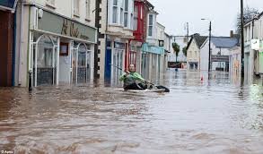
What are the different strategies used to try and prevent or manage flooding?
L/O
To be able to explain the advantages and disadvantages of the different methods used to prevent or manage floods.

Slide 2
Hard Engineering
Projects which use human-made structures to control a river and help prevent flooding
Hard engineering involves the building of entirely ARTIFICIAL structures using various materials such as rock, concrete and steel to reduce or stop the impact of river processes.

Slide 3
Soft Engineering
Projects which work with the natural environment to help prevent flooding

Slide 4
Independent Learning
Now make two columns in your book. Label one column Soft Engineering and the other Hard engineering.
Look at the next set of images and write them into the column that you think they should go.

Slide 5
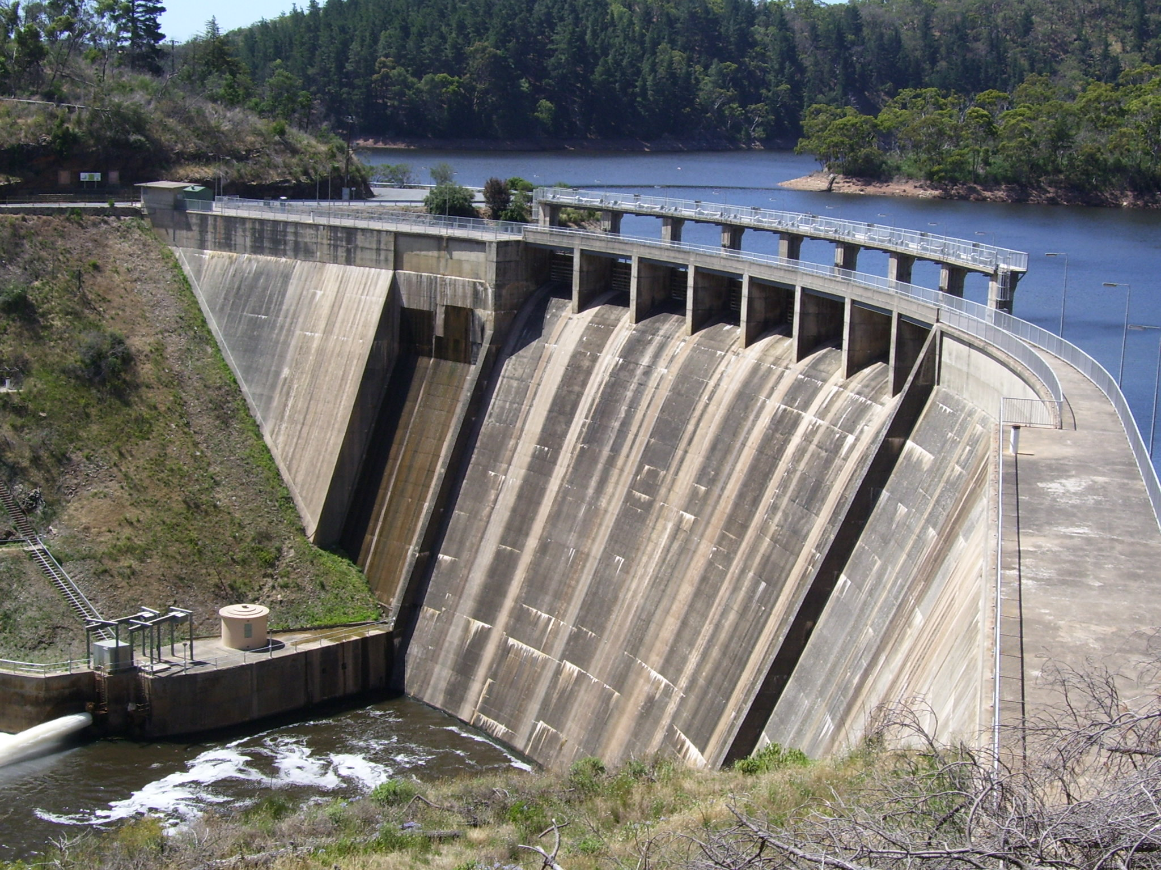
Dams & Reservoirs

Slide 6
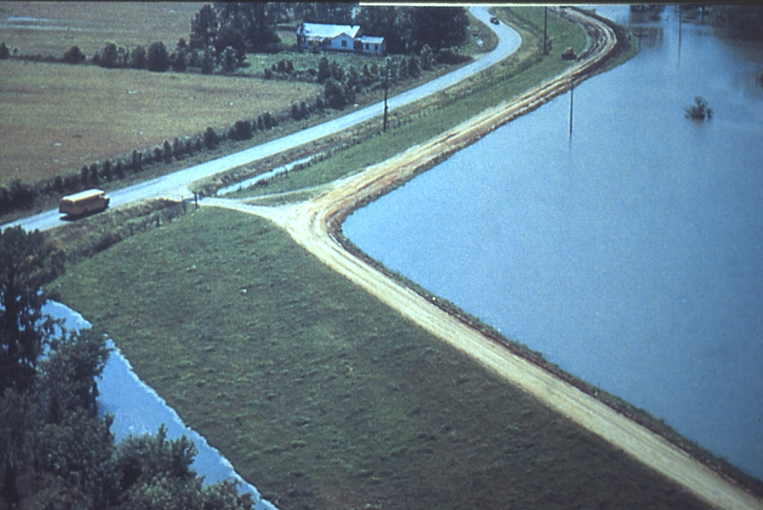
Describe the photo & explain how it works
Levees

Slide 7
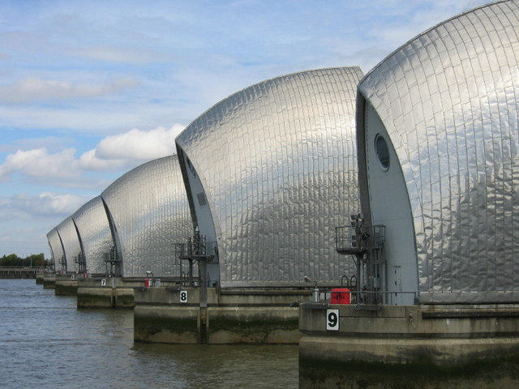
Flood Barriers

Slide 8
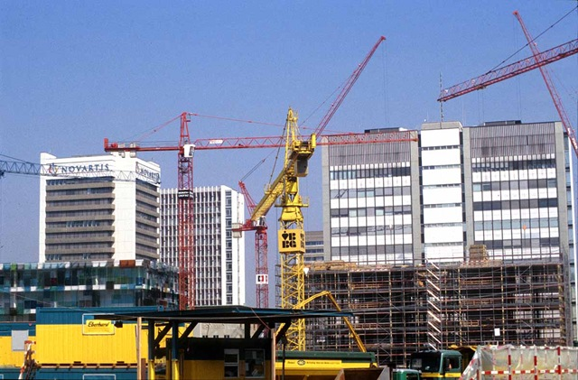

Slide 9
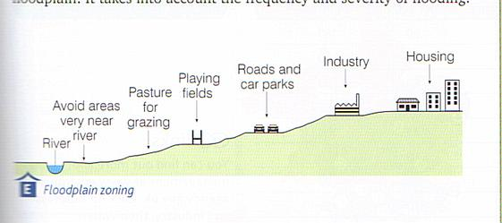
Flood plain zoning

Slide 10
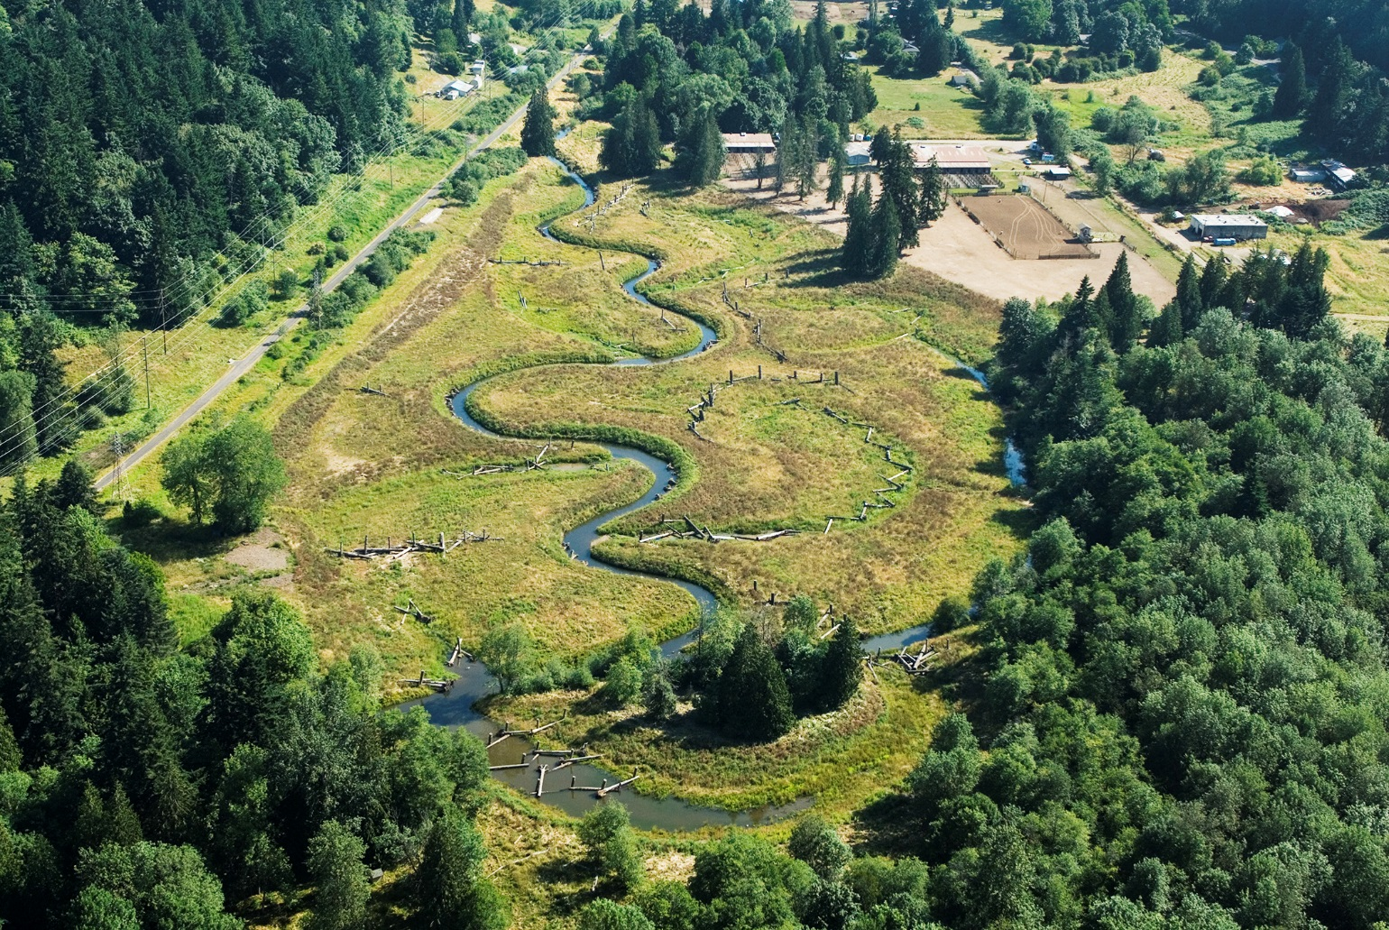
Describe the photo & explain how it works
Floodplain Restoration

Slide 11
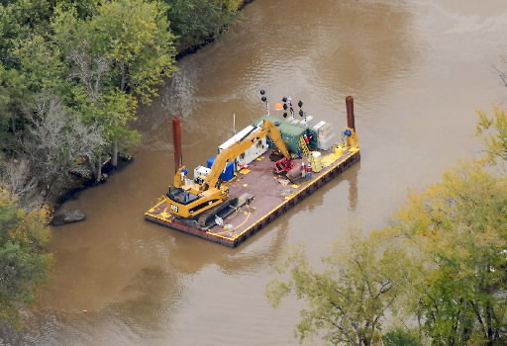
Describe the photo & explain how it works
Dredging

Slide 12
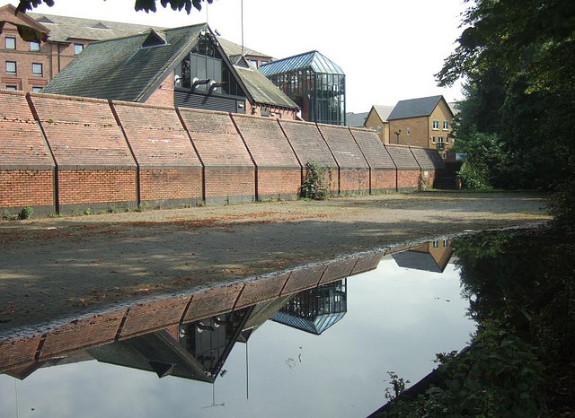
Describe the photo & explain how it works
Flood Walls

Slide 13
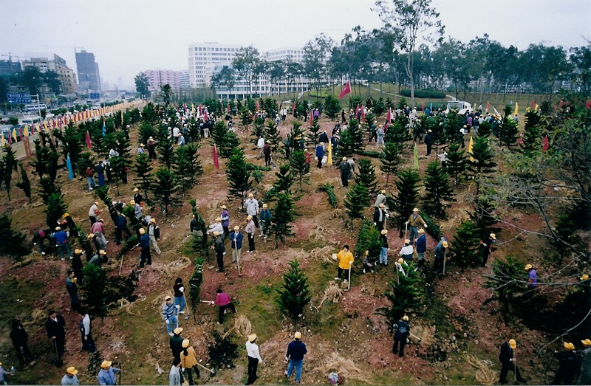
Afforestation

Slide 14
Advantages and disadvantages of different types of flood defences.
Dam- Advantages-
Most effective form of flood defence.
Can be used to make HEP.
Attracts tourists.
Disadvantages-
Area behind dam gets flooded settlements lost.
Sediment builds up behind dam causing pollution.
Is enormously expensive to build.
Levees- Advantages
Look natural, blend in with their surroundings.
Not as expensive as dams.
Disadvantages-
Easily breached at times of heavy flooding

Slide 15
Flood wall- Advantages
Good at protecting properties where the walls have been built.
Not too intrusive. Do not really spoil the environment.
Disadvantages
They are localised. They only protect buildings along short stretches of the river.
During heavy floods water will circumnavigate the walls and flooding will occur naturally.
Afforestation Advantages
Trees blend well into and even improve the environment.
Planting trees reduces global warming.
Planting trees does not interfere with the river’s natural cycle.
Disadvantages.
Trees take a long time to grow to maturity. Much damage can be caused by the time that they don.
Planting trees will not reduce the risk of really heavy flooding.

Slide 16
Dredging Advantages-
The effects of dredging are instantaneous. The river channel is deepened, therefore reducing the risk of flooding.
Disadvantages-
Dredging is very expensive.
Dredging is noisy.
The river soon re-fills up full of sediment, so the process has to be repeated often.
Overall hard engineering strategies are the most effective. Particularly, dams and barriers. However, they tend to be costly and can cause other problems. Some of which are very serious. In an ideal world using soft engineering would be best. These work in harmony with nature. They do not have an environmental effect. However, they are nowhere near as effective as hard engineering strategies.

